Slide 1
Adapting to a Changing Climate: Tools and Resources to Increase Vineyard Resilience and Reduce Vineyard Carbon Footprints
Notes:
Allison introduce topic

Slide 2
Today’s Agenda
Introductions
Context Setting
On-the-Ground Adaptation Examples
Discussion and Q&A
Tools & Resources

Slide 3
Climate Smart Winegrowing
ACCELERATING SUSTAINABLE AGRICULTURE
DECARBONIZING ENERGY
FOSTERING A NET ZERO VALUE CHAIN
BUILDING RESILIENCY
Notes:
Useful way to think about climate smart winegrowing

Slide 4
SCIENCE BASED
Sustainable Winegrowing is Climate Smart
California Code of Sustainable Winegrowing
Business Strategy
Viticulture
Soil Management
Vineyard & Winery Water Management
Water Quality
Pest Management
Wine Quality
Ecosystem Management
Energy Efficiency
Material Handling
Solid Waste Management
Sustainable Purchasing
Human Resources
Neighbors & Community
Air Quality & Climate Protection
4th Edition
15 Chapters
148 Vineyard Best Practices
108 Winery Best Practices
Learn more at: sustainablewinegrowing.org
Notes:
Covers many issue areas related to climate change mitigation and adaptation

Slide 5
Climate Smart Practices
Notes:
Shows climate smart practices are familiar to those using sustainable practices

Slide 6
Sustainability Metrics
Linking Practice with Performance
Measuring to manage results in better decisions and greater impact
Benchmarking leads to meaningful continuous improvement plans
Notes:
Performance metrics – required for certification – also have direct links to climate change

Slide 7
Past Climate Smart Projects
Denitrification Decomposition (DNDC) Model
Vineyard Emissions
Vineyard Management
Guidance
Industry tools to drive
sustainability
improvement
Cradle-to-Grave Carbon Footprint of 9L of Wine
Performance Metrics
Scope 1 & 2 for Vineyards and Wineries
Notes:
This work isn’t new. Over the past two decades, we’ve undertaken several projects to better understand the carbon footprint of vineyards and wineries and to develop tools to help drive improvement.

Slide 8
SCIENCE BASED
California Wine’s Carbon Footprint
Identifying areas for continuous improvement
Notes:
One example is the carbon footprint of CA wine (conducted in 2011), and you can see the major vineyard emissions come from field emissions and the production of raw material, with smaller contributions from fuel production and electricity use.

Slide 9
Current Climate Smart Project
2023-2025
California Climate Hub literature review on impacts & adaptation
Winegrower working groups and roundtables
“Climate smart toolbox" of practices, tools, case studies, etc.
Cost-share opportunities
Workshops and webinars
Communication materials for winegrowers, trade & consumers
Notes:
We have a current project that involved a literature review to help identify potential impacts and adaptation strategies, which we’ll talk more about today.

Slide 10
Many Ways to Be Sustainable: U.S.
Check winery websites and look for
certification signs in vineyards and tasting rooms sustainablewinegrowing.us
Notes:
So far, talking about some of CSWA’s activities, but there are many ways to be sustainable – including these US programs – and globally. All of these programs address climate smart practices and, in most cases, metrics.

Slide 11
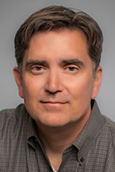
Adapting to a Changing Climate: Tools and Resources to Increase Vineyard Resilience and Reduce Vineyard Carbon Footprints
Dr. John Heckman

Slide 12
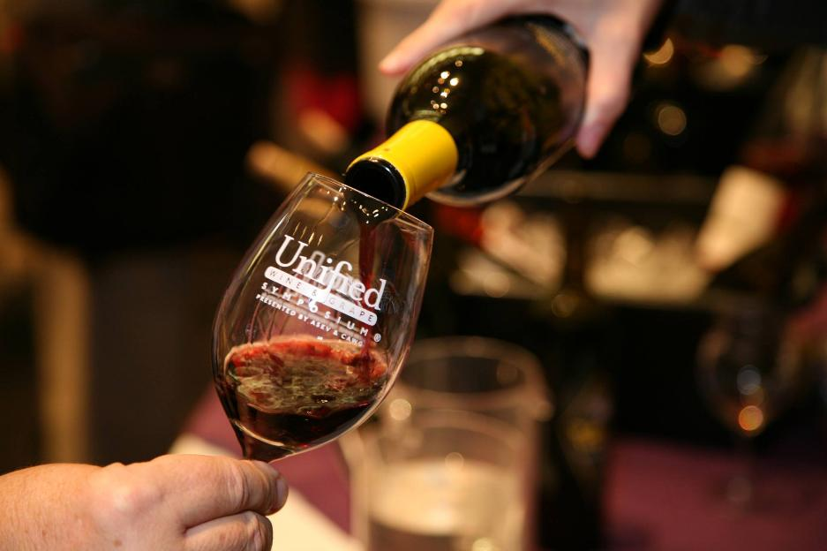
Grounding Ourselves
This is a hard conversation
Hard conversations are worthwhile
We have a lot to learn, and a great community for collaboration

Slide 14
Climate Risk is Well Established
Corporate experience
Physical Risks
Transition Risks
Industry Guidance
>$20bn in research to date

Slide 15
Physical Risks
Temperature
“The daily maximum average temperature, an indicator of extreme temperature shifts, is expected to rise 4.4–5.8⁰F by mid-century”
Precipitation
“… drought severity and the number of dry years will increase, even as more extreme precipitation events may occur.”
Wildfire
“… projected up to a 77% increase in average area burned and a 50% increase in the frequency of fires exceeding 25,000 acres by 2100.”
Sea-level rise, coastal flooding, and erosion
“will increase flood impacts on land, … exacerbate the impact on coastal assets … may also salinate coastal groundwater aquifers and raise groundwater tables
Ocean warming, hypoxia, and acidification
“warming and acidification can be catastrophic to marine ecosystems (e.g. disease, degradation, bleaching) and the coastal communities and industries that rely on them.”
Human Health
“Climate change is considered the greatest global public health threat of the 21st century”
https://climateresilience.ca.gov

Slide 16
Current Research
Lauren E. Parker et. al, 2024, “A variety-specific analysis of climate change effects on California winegrapes”, International Journal of Biometeorology 68:1559-1571.
Models six winegrape varieties over 12 of California AVAs by the mid-21st century.
Results show more rapid development for winegrapes with earlier budburst, flowering, veraison, and maturation
Cabernet Sauvignon shows the greatest change, while Chardonnay shows the least change.
Projected changes in agroclimatic metrics include an additional month of potentially damaging heat days (above 35⁰ C) in some AVAs, and decreases in frost days.
https://www.climatehubs.usda.gov/hubs/california/topic/future-winegrapes-california
https://doi.org/10.1007/s00484-024-02684-8

Slide 17
Current Research
These results have implications for numerous factors related to viticultural production, including water resources management and crop yield and quality, and underscore the need for California winegrape growers to improve their resilience to climate change by adopting strategies such as increasing soil health and water use efficiency and selecting cultivars suited for future climate conditions.
By conducting climate effects analyses at the variety-specific and AVA scale, important information is provided to the winegrowing industry at a resolution that can support decision-making towards resilience.
More publications coming:
Parker et al. (2024). Managing California’s Vineyards for a Changing Climate, Part 1 and Part 2: Science-backed Actions for Adaptation and Mitigation. In Review.
https://www.climatehubs.usda.gov/hubs/california/topic/future-winegrapes-california
https://doi.org/10.1007/s00484-024-02684-8

Slide 18
Four Responses to Risk

Slide 19
We Have Work to Do
Strategy 1: Support and Maintain Soil Health, Soil Biological Services, and Water Quality
Strategy 2: Cope with Uncertain Water Availability
Strategy 3: Manage Biological Crop Stressors
Strategy 4: Prepare for Temperature Change
Strategy 5: Enhance Preparedness for Extreme Events
Strategy 6: Manage Farms and Fields as Part of a Larger Landscape
Strategy 7: Develop or Expand Co-Benefit Efforts to Mitigate Climate Change
Notes:
John – lots of things we can do

Slide 20
Climate Smart Toolkit is Coming
Notes:
John to introduce; Lisa to add graphic
To help make sense, existing tools, focus and wrap heads around – can enter in so many ways, regardless of where you are

Slide 21
Step by Step
Notes:
John to introduce; Lisa to add graphic
To help make sense, existing tools, focus and wrap heads around – can enter in so many ways, regardless of where you are

Slide 22
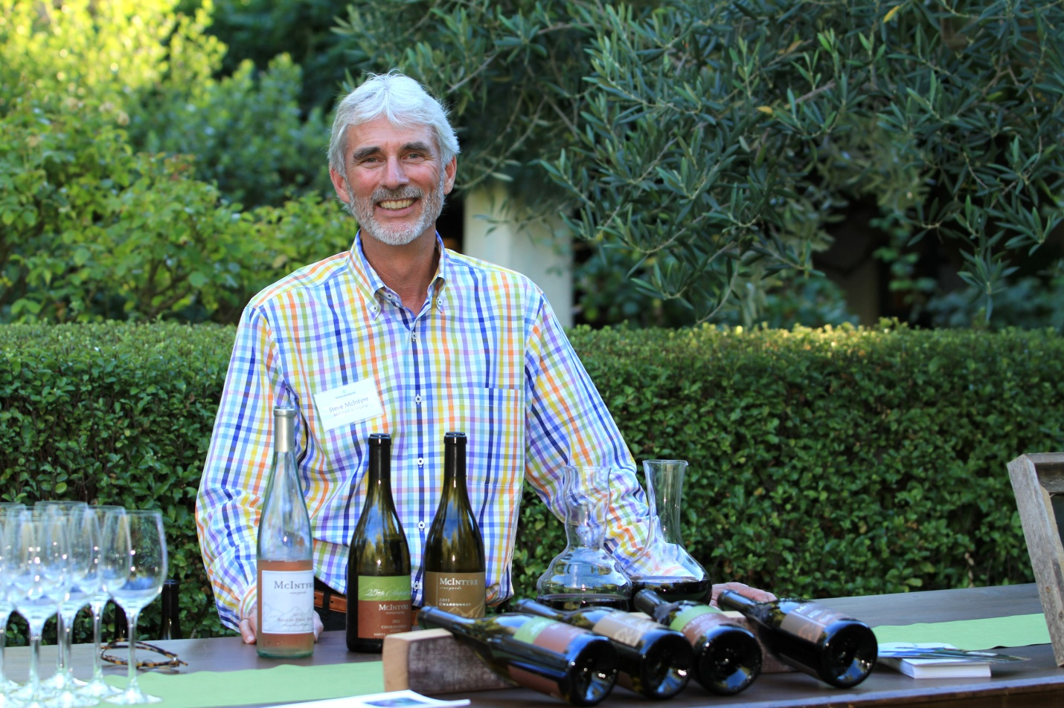
Adapting to a Changing Climate: Tools and Resources to Increase Vineyard Resilience and Reduce Vineyard Carbon Footprints
Steve McIntyre
Monterey Pacific, LLC

Slide 23
Slide w/ info & image
Romanee Conti Grand Cru Vine

Slide 24
Shade Cloth Application

Slide 25
Mechanical High Wire Trellis

Slide 26
Sitos Biochar Project

Slide 27
Discussion Q&A

Slide 28
Tools & Resources
Climate Action Toolkit – coming soon! Please sign up to Beta Test
Resources, workshops & webinars sustainablewinegrowing.org
USDA Climate Hubs climatehubs.usda.gov
West Coast Smoke Exposure Task Force wcsetf.org

